Slide 1

Hamiltonian Knight’s tour on a chessboard
Name-Arnab Biswas
Roll-21EC65R01

Slide 2
Problem Statement A knight tour problem is a mathematical problem involving a knight on a chessboard. The knight of the chessboard is moved according to the rules of the chessboard. A knight tour is a sequence of moves of a knight on a chessboard such that the knight visits every sequence only once. So, we can say that it is an instance of more general Hamiltonian path problem in Graph Theory. The problem of finding a closed knight's tour is similarly an instance of the Hamiltonian Cycle Problem.

Slide 3

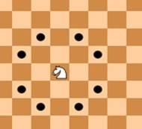
The Knight's Legal Move The knight may move two squares vertically and one square horizontally, or two squares horizontally and one square vertically (with both forming the shape of an L). This way, a knight can have a maximum of 8 moves.

Slide 4
Relation Between Knight Tour and Graph
We can represent the Hamiltonian Knight Tour as following:
1. The vertices of the graph represent the square of the board.
2. The edges of the graph represent the knight's legal move between the squares.

Slide 5
Types of Knight's Tour Problem
Open Tour: If the beginning square cannot be reached, then the we can say that the tour is an open tour.
01
Closed Tour: If knight ends on a square from which the starting square can be reached by the knight, then we can say that it is a closed tour.
02

Slide 6
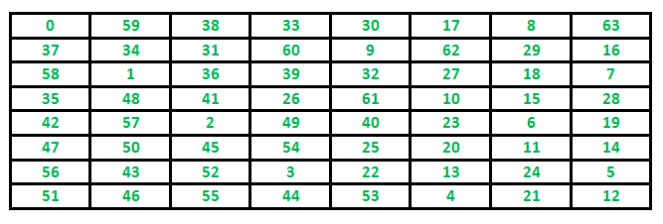
Open Tour
In the diagram, we can see that in the 8x8 chessboard, the starting position is in the topmost left corner and the ending position is at the topmost right corner. So, knight cannot move from the ending point to the starting point by any legal move.

Slide 7
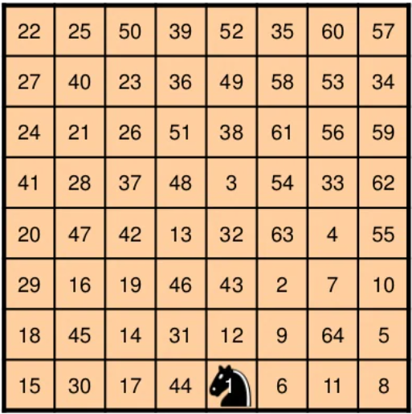
Closed Tour
In this diagram, we can say that from the ending point, we can reach the starting point using the legal move. So, this is a closed tour.

Slide 8
Schwenk's Theorem
A mxn chessboard with m≤n has a closed knight tour unless one or more than one of the following three conditions hold:
1. m and n both are odd.
2. m=1, 2 or 4
3. m=3 and n=4 or 6 or 8

Slide 9
Various Algorithms
1. Brute Force Algorithm
2. Divide and Conquer
3. Warnsdorff's Rule

Slide 10
Brute Force Algorithm
1. Very general problem technique.
2. Iterates through all possible move sequence.
3. It is basically a depth-first-search with backtracking.
4. For a regular 8x8 chessboard, there are approximately 4x10⁵¹ possible moves sequences.

Slide 11
Divide and Conquer
Divide
Divide the board into smaller pieces.
Construct
Construct tours on each piece.
Patch
Patch all pieces together.

Slide 12
Warnsdorff's Algorithm
1. Introduced by H.C.Warnsdorff in 1823
2. Can be solved in linear time.
3. Very efficient and most popular algorithm for solving knight tour problem.
4. The rule says that we can start from any initial position of the knight on the board, and we always move to an adjacent, unvisited square with minimal degree (minimum number of unvisited adjacent).
5. This algorithm gives the closed knight tour.

Slide 13
Warnsdorff's Algorithm
A position Q is accessible from a position P if P can move to Q by a single knight move and Q has not visited yet.
The accessibility of a position P is the number of positions accessible from P.
Algorithm:
Set P to be a random initial position on the board
Mark the board at P with the move number “1”
Do following for each move number from 2 to the number of squares on the board
let S be the set of positions accessible from P.
Set P to be the position in S with minimum accessibility
Mark the board at P with the current move number
4. Return the marked board — each square will be marked with the move number on which it is visited.

Slide 14
Warnsdorff’s Rule:
Always move to an adjacent, unvisited square with minimal degree.
The idea is to deviate at an early move so that we have a greater opportunity.
It is impossible for a knight’s tour to deviate from Warnsdorff’s Rule in the last four moves.
It is not an algorithm and we can start from any square of the chessboard.

Slide 15
Proof:
Suppose we can deviate from Warnsdorff’s Rule at the current move of a path and still produce a tour. In particular, suppose we move to a square of degree y instead of a square of degree x, where x < y. Let q denote the current square, p denotes the square of degree x, and r denotes the square of degree y. If x = 0, then it is impossible to produce a tour since we can never visit p. So x ≥ 1. Therefore, y ≥ 2. So at least three squares must currently be unvisited; otherwise no square could have degree 2. If exactly three squares are unvisited, then we must have x = 1 and y = 2. Then r must be adjacent to p since only three squares remain. Therefore q, p, and r are mutually adjacent. By the lemma this produces a contradiction.

Slide 16
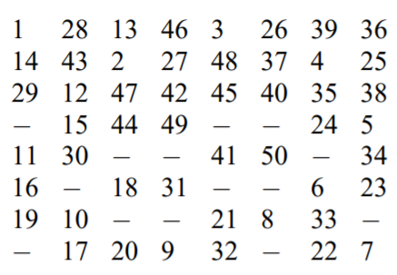
Drawback
Warnsdroff does not provide a rule if there are many minimal degrees.
In this figure, we can see that inspite of strictly follows the rule, the path is incomplete.
In 1996, Squirrel and Douglas have found that this rule can find Knight tour can be possible for smaller size chessboard.

Slide 17
Improvement of Warnsdorff's Rule
At first, Parberry has proposed a method that combined Warnsdorff’s heuristic with a random walk algorithm originally proposed by Euler in 1759. But the success rate has appreaed to decrease and time complexity increases.
Roth proposed breaking ties by choosing the successor with largest euclidean distance to the center of the chessboard. His algorithm first failed at 428 rows.
Pohl decided to apply Warnsdorff’s rule a second time on the squares that share the minimal degree. He proposed taking the sum of the degrees of all the unvisited neighbors of these minimal-degree squares and choosing the square whose sum was minimal.

Slide 18
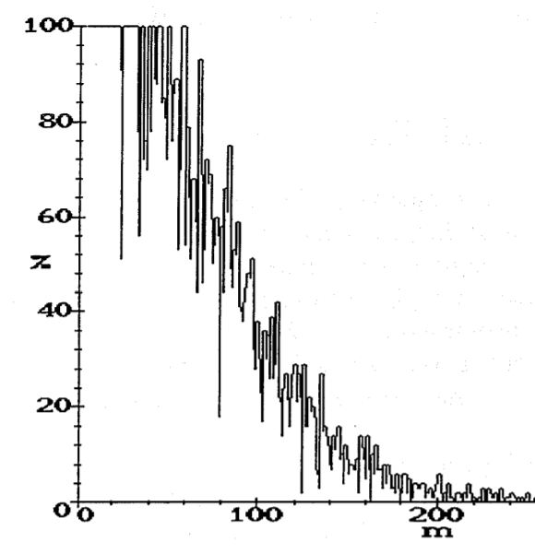
Success Rate of Random Tie-break
This graph is experimented by Squirrel. Here, Roth has claimed that his algorithm works well up to 400 rows while Pohl has claimed that his algorithm is succeeded over 95% of the time on nearly all boards with up to 100 rows.

Slide 19
Magic Knight Tour
The squared of the chess board are numbered in the order of the knight's move.
Full magic tour means each column, row and diagonal must sum to the same number. The number is called magic number.
Magic knight tour means each column and row must sum to the same number.

Slide 20
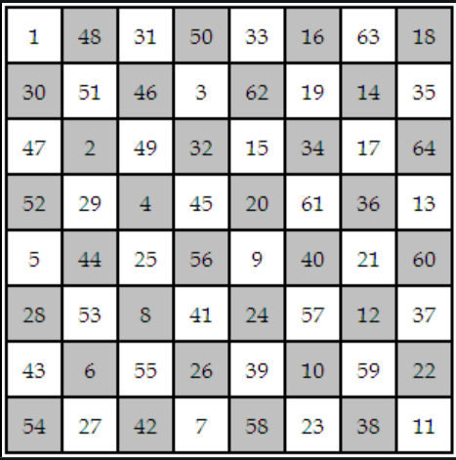
Magic Knight Tour Example
In this figure, the sum of any row or the sum of any column is equal to 260. So, in this example 260 is the magic number.

Slide 21
Full magic knight tour
Existence of full magic knight tour on a 8x8 chessboard is a 150 years problem. William Beverley is the first composer of this problem.
On August 5, 2003, after nearly 62 computational days, a search by J-C. Meyrignac and H. Mackay show that no 8x8 full magic knight tour is possible.
Also, on March 2003 Awani Kumar (India) solved the long-standing problem of a diagonally magic tour on the 12×12 board, obtaining four examples.

Slide 22
Summary
Warnsdroff Rule is very efficient to find the closed knight tour. But this rule cannot find the knight tour for rows number greater than 100 efficiently.
Both Roth and Pohl introduced the idea of breaking ties according to a fixed ordering of moves rather than using Warnsdorff’s random rule.
Full magic knight tour is not possible for 8x8 chessboard.

Slide 23
Thank You

